Slide 1
Unit 3
Uniprocessor Scheduling
, Deadlock

Slide 2
CPU-scheduling algorithms
In case of multiprogramming, CPU needs to be scheduled, so that multiple works can be performed simultaneously in less time or at a same time.
By CPU scheduling it is decided which of the processes in the ready queue is to be allocated in the CPU.

Slide 3
FCFS (FIRST-COME, FIRST-SERVED) Scheduling
In FCFS algorithm, the process that requests the CPU first is allocated in the CPU first.
The implementation of FCFS algorithm is managed with FIFO (First in first out) queue.
FCFS scheduling is non-preemptive.
Nonpreemptive means, once the CPU has been allocated to a process, that process keeps the CPU until it executes a work or job or task and releases the CPU, either by requesting I/O.

Slide 4

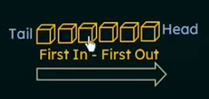
Real life example

Slide 5
Terminologies Used in CPU Scheduling
Arrival Time: The time at which the process arrives in the ready queue.
Burst Time: The time that a process required for execution
Completion Time: The time at which the process completes its execution.
Turn Around Time: Time Difference between completion time and arrival time.
Turn Around Time = (Completion Time – Arrival Time)
Waiting Time (W. T): Time Difference between turnaround time and burst time .
Waiting Time = (Turn Around Time – Burst Time).
Gantt Chart - Gantt chart is used for visualization , which helps to scheduling and managing particular tasks in a project.

Slide 6
Implementation
1 - Input the processes along with their burst time (bt).
2 - Find waiting time (wt) for all processes.
3 - As first process that comes need not to wait so waiting time for process 1 will be 0 i.e. wt[0] = 0.
4 - Find waiting time for all other processes i.e. for process i -> wt[i] = bt[i-1] + wt[i-1] .
5 - Find turnaround time = waiting_time + burst_time for all processes.
6 - Find average waiting time = total_waiting_time / no_of_processes.
7 - Similarly, find average turnaround time = total_turn_around_time / no_of_processes.

Slide 7
Problem 1
Consider the given table below and find Completion time (CT), Turn-around time (TAT), Waiting time (WT), Average Turn-around time and Average Waiting time.
Process ID | Arrival time | Burst time
P1 | 2 | 2
P2 | 5 | 6
P3 | 0 | 4
P4 | 0 | 7
P5 | 7 | 4

Slide 8
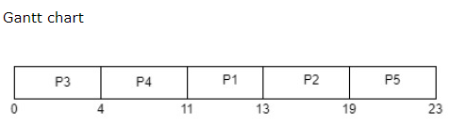
Process ID | Arrival time | Burst time | CT | TAT=CT-AT | WT=TAT-BT
P1 | 2 | 2 | 13 | 13-2= 11 | 11-2= 9
P2 | 5 | 6 | 19 | 19-5= 14 | 14-6= 8
P3 | 0 | 4 | 4 | 4-0= 4 | 4-4= 0
P4 | 0 | 7 | 11 | 11-0= 11 | 11-7= 4
P5 | 7 | 4 | 23 | 23-7= 16 | 16-4= 12
Average Waiting time = (9+8+0+4+12)/5 = 33/5 = 6.6 milliseconds
Average Turn-around time = (11+14+4+11+16)/5 = 56/5 = 11.2 milliseconds

Slide 9
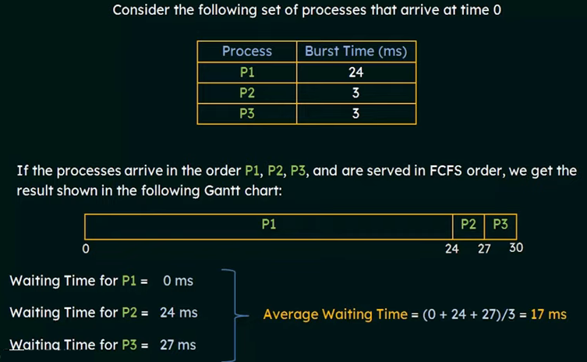

Slide 10
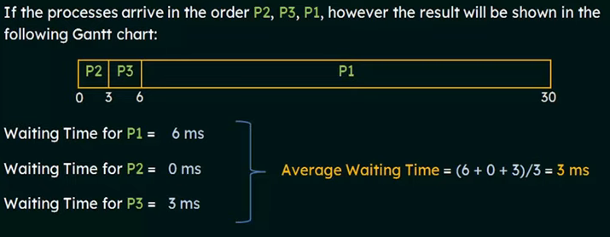
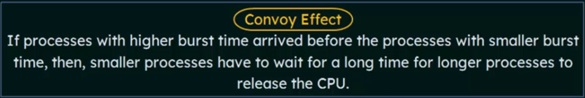

Slide 11
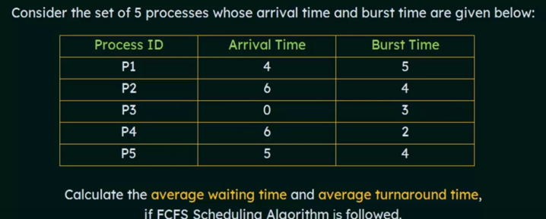
Problem 3

Slide 12
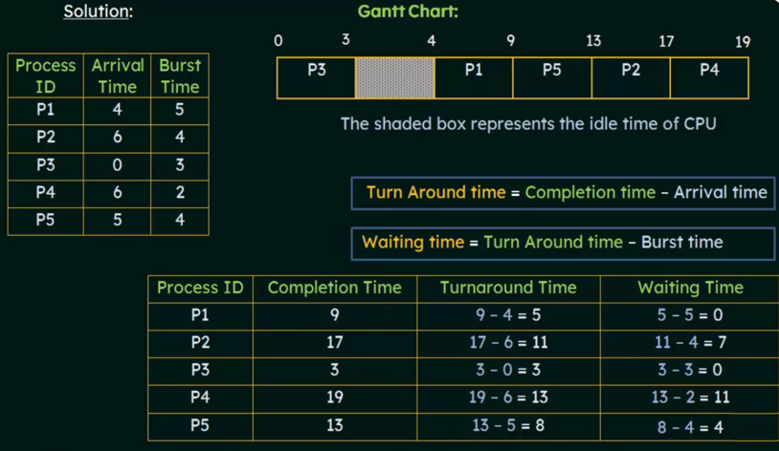

Slide 13
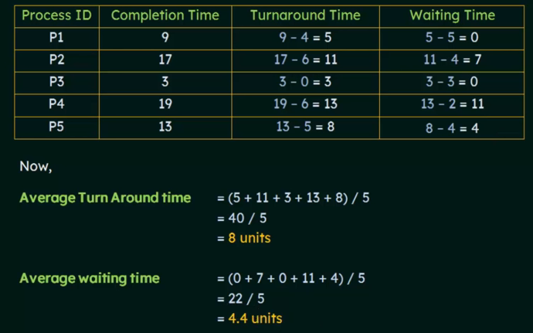

Slide 14
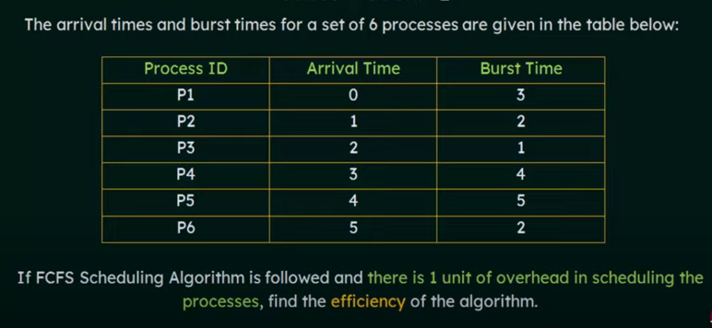
Problem 4
Overhead= delay

Slide 15
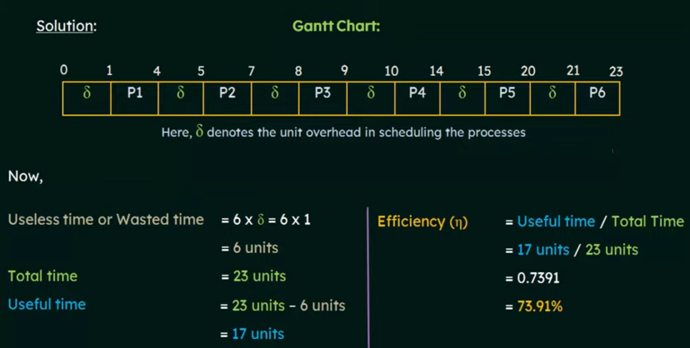
= 1 unit of Overhead/delay

Slide 16
Advantages Of FCFS Scheduling
It is an easy algorithm to implement since it does not include any complex way.
Every task should be executed simultaneously as it follows FIFO queue.
FCFS does not give priority to any random important tasks first so it’s a fair scheduling.

Slide 17
Disadvantages Of FCFS Scheduling
FCFS results in convoy effect which means if a process with higher burst time comes first in the ready queue then the processes with lower burst time may get blocked and that processes with lower burst time may not be able to get the CPU if the higher burst time task takes time forever.
If a process with long burst time comes in the line first then the other short burst time process have to wait for a long time, so it is not much good as time-sharing systems.
Since it is non-preemptive, it does not release the CPU before it completes its task execution completely.
FCFS is not good for interactive system and not used in modern operating systems

Slide 18
SJF -
Shortest Job First
Algorithm
(non-preemptive
& Preemptive)

Slide 19
SJF-shorted Job First
SJF scheduling algorithm, schedules the processes according to their burst time.
In SJF scheduling, the process with the lowest burst time, among the list of available processes in the ready queue, is going to be scheduled next.
If the next CPU bursts of two processes are the same ,FCFS scheduling is used .
It can be either preemptive or non-preemptive
Also called Shortest Job Next (SJN).

Slide 20
How to compute below times in SJF using a program?
Completion Time: Time at which process completes its execution.
Turn Around Time: Time Difference between completion time and arrival time. Turn Around Time = Completion Time – Arrival Time
Waiting Time(W.T): Time Difference between turn around time and burst time. Waiting Time = Turn Around Time – Burst Time

Slide 21
Consider the following set of processes , with the length of the CPU burst given in milliseconds
Process ID | Burst Time
P1 | 6
P2 | 8
P3 | 7
P4 | 3
Gantt Chart:
0
3
9
16
24
P4
P1
P3
P2

Slide 22
Process ID | Burst Time | Completion Time | Turn Around Time | Waiting Time | Response Time
P1 | 6 | 9 | 9 | 3 | 3
P2 | 8 | 24 | 24 | 16 | 16
P3 | 7 | 16 | 16 | 9 | 9
P4 | 3 | 3 | 3 | 0 | 0
Arrival time not given
Avg waiting Time = (3+16+9+0)/4 = 28/4 = 7ms.
Avg TAT = (9+24+16+3)/4 = 52/4 = 13ms.

Slide 23
Example 2: preemptive
Process | Arrival Time | Burst Time | Completion Time | Turn Around Time | Waiting Time
P1 | 0 | 7 | 7 | (7-0) = 7 | (7-7)=0
P2 | 2 | 4 | 12 | (12-2) = 10 | (10-4)=6
P3 | 4 | 1 | 8 | (8-4) = 4 | (4-1)=3
P4 | 5 | 4 | 16 | (16 –5)= 11 | (11-4)=7
0
7
8
12
16
P1
P3
P2
P4
Avg Waiting Time = (0+6+3+7)/4 = 16/4 = 4ms
Avg TAT = (7+10+4+11)/4 = 32/4 = 8ms

Slide 24
preemptive (SRTF: Shortest Remaining Time First)
If a process with the least short time arrives, the current process in execution will be stopped and preempted from the execution, and the shortest process is allocated to the CPU cycle.

Slide 25
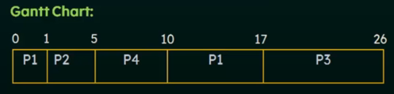
Example 3: preemptive (SRTF: Shortest Remaining Time First)
Process | Arrival Time | Burst Time | Completion Time | Turn Around Time | Waiting Time
P1 | 0 | 8 | 17 | 17 | 9
P2 | 1 | 4 | 5 | 4 | 0
P3 | 2 | 9 | 26 | 24 | 15
P4 | 3 | 5 | 10 | 7 | 2
Avg Waiting Time = 26/4 = 6.5ms
Avg TAT = 52/4 = 13ms

Slide 26

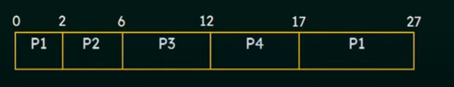
Example 4: preemptive
Process | Arrival Time | Burst Time | Completion Time | Turn Around Time | Waiting Time
P1 | 0 | 12 | 27 | 27 | 15
P2 | 2 | 4 | 6 | 4 | 0
P3 | 3 | 6 | 12 | 9 | 3
P4 | 8 | 5 | 17 | 9 | 4
Avg Waiting Time = 22/4 = 5.5ms

Slide 27
Example 5: preemptive
Process | Arrival Time | Burst Time | Completion Time | Turn Around Time | Waiting Time | Response Time
P1 | 0 | 5 | 9 | 9 | 4 | 0
P2 | 1 | 3 | 4 | 3 | 0 | 0
P3 | 2 | 4 | 13 | 11 | 7 | 7
P4 | 4 | 1 | 5 | 1 | 0 | 0
0
1
4
5
9
13
P1
P2
P4
P1
P3
Response Time =(CPU first time-AT)
Avg Waiting Time = 11/4 = 2.75ms Avg TAT = 24/4 =6ms

Slide 28
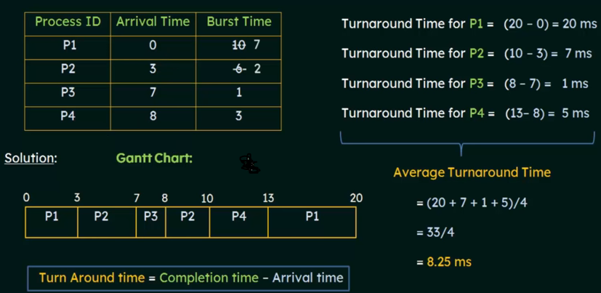
Example 6

Slide 29
Round Robin
Scheduling Algorithm

Slide 30
Round-robin scheduling algorithm
The Round-robin scheduling algorithm is a kind of preemptive First come, First Serve CPU Scheduling algorithm
where each process in the ready state gets the CPU for a fixed time of time quantum in a cyclic way (turn by turn).
In this algorithm, every process gets executed in cyclic mode.
It is used in Time Sharing or multitasking OS .
It perform context switching and save the states of preempted processes.

Slide 31
Round-robin scheduling algorithm
This means that processes that have their burst time remaining after the expiration of the time quantum are sent back to the ready state and wait for their next turn to complete the execution until it terminates.
This processing is done in FIFO order which suggests that processes are executed on a first-come, first-serve basis.

Slide 32
How does the Round Robin Algorithm Work?
All the processes are added to the ready queue.
At first, The burst time of every process is compared to the time quantum of the CPU.
If the burst time of the process is less than or equal to the time quantum in the round-robin scheduling algorithm, the process is executed to its burst time.
If the burst time of the process is greater than the time quantum, the process is executed up to the time quantum (TQ).

Slide 33
How does the Round Robin Algorithm Work?
When the time quantum expires, it checks if the process is executed completely or not.
On completion, the process terminates. Otherwise, it goes back again to the ready state.

Slide 34
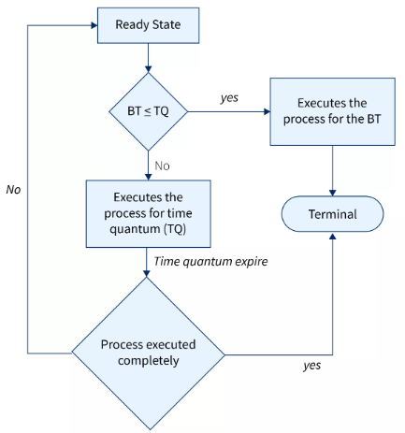
Flow diagram: How does the Round Robin Algorithm Work?

Slide 35

Example 1
Process ID | Arrival Time | Burst Time
P1 | 0 | 5
P2 | 1 | 4
P3 | 2 | 2
P4 | 4 | 1
We have to calculate:
Turn Around Time = CT-AT
WT = TAT-BT
RT=(CPU first Time- AT)
Time quantum = 2ms

Slide 36
Process ID | Arrival Time | Burst Time | CT | TAT | WT | RT
P1 | 0 | 5 3 1 0 | 12 | 12 | 7 | 0
P2 | 1 | 4 2 0 | 11 | 10 | 6 | 1
P3 | 2 | 2 0 | 6 | 4 | 2 | 2
P4 | 4 | 1 0 | 9 | 5 | 4 | 4
Time quantum
= 2ms
Ready Queue
P1
P2
P3
P1
P4
P2
P1
Context switching
P1
P2
P3
P1
P4
P2
P1
Running Queue Gantt Chart
0
2
4
6
8
9
11
12
Time

Slide 37
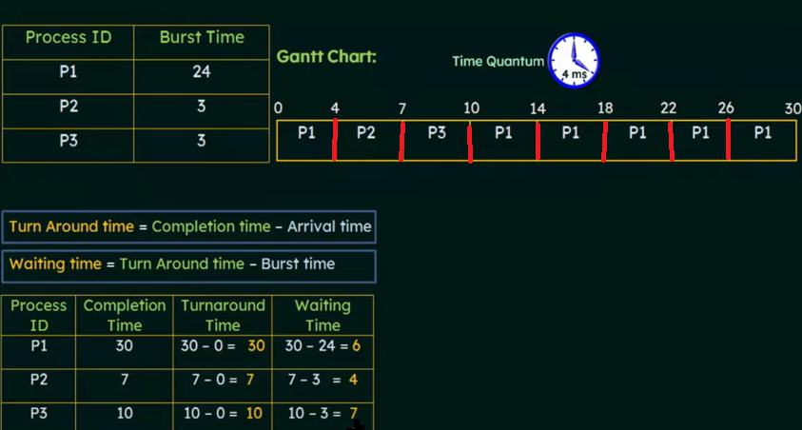
Example 2

Slide 38
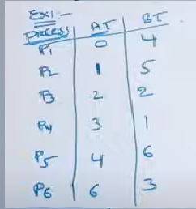
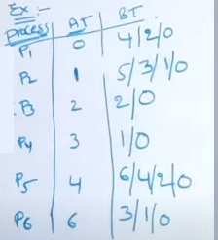
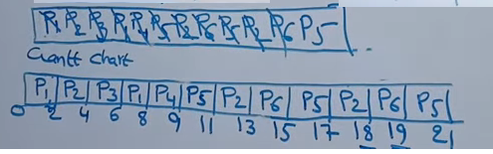
Example 3
Time quantum = 2ms
Ready Queue
Running Queue Gantt Chart

Slide 39
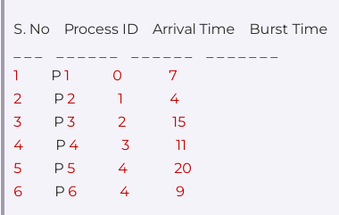

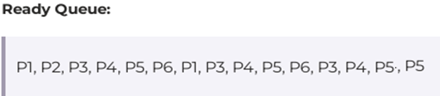
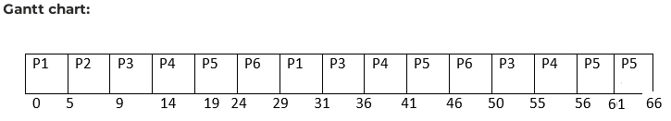
Example 4

Slide 40
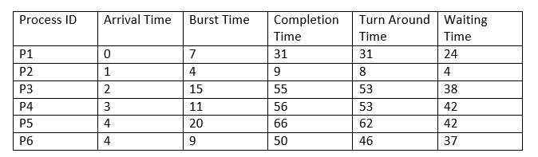
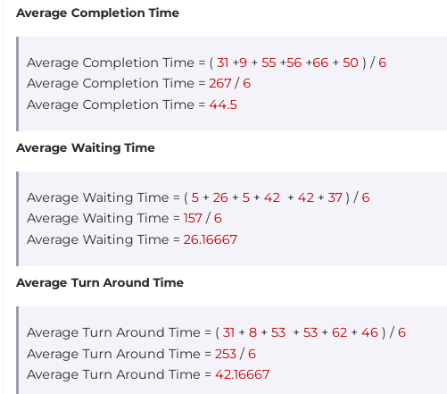
Example 4 Answer

Slide 41
Priority Scheduling Algorithm

Slide 42
Priority scheduling algorithm
Priority scheduling in OS is the scheduling algorithm that schedules processes according to the priority assigned to each of the processes.
Higher priority processes are executed before lower priority processes.
Processes with the same priority are executed on a first-come first served basis.
In priority scheduling, a number is assigned to each process that indicates its priority level.
Priority scheduling algorithm can be used in both preemptive and non-preemptive mode.

Slide 43
Types of Priority Scheduling Algorithms
Non-Preemptive Scheduling
In this type of scheduling:
If during the execution of a process, another process with a higher priority arrives for execution, even then the currently executing process will not be disturbed.
The newly arrived high priority process will be put in next for execution since it has higher priority than the processes that are in a waiting state for execution.
All the other processes will remain in the waiting queue to be processed.
Once the execution of the current process is done, the high-priority process will be given the CPU for execution.

Slide 44
Types of Priority Scheduling Algorithms
Preemptive Scheduling
Preemptive Scheduling as opposed to non-preemptive scheduling
It will preempt (stop and store the currently executing process) the currently running process
if a higher priority process enters the waiting state for execution and it will execute the higher priority process first and then resume executing the previous process.

Slide 45
Non-Preemptive Priority Scheduling-Example 1
Process ID | Priority | Burst Time
P1 | 3 | 10
P2 | 1 | 1
P3 | 4 | 2
P4 | 5 | 1
P5 | 2 | 5
TAT | WT
16 | 6
1 | 0
18 | 16
19 | 18
6 | 1
Lower the number , higher the priority & AT = 0
Here AT is 0 so TAT = CT
WT is calculate from Gantt chart
Avg TAT= 60/5 = 12 ms &
Avg WT= 41/5 = 8.2 ms
P2
P5
P1
P3
P4
Gantt Chart
0
1
6
16
18
19

Slide 46
Non-Preemptive Priority Scheduling-Example 2
Process ID | Arrival Time | Burst Time | Priority
P1 | 0 | 12 | 4
P2 | 4 | 7 | 3
P3 | 7 | 3 | 1
P4 | 9 | 3 | 2
P5 | 12 | 2 | 2
CT | TAT | WT
12 | 12 | 0
27 | 23 | 16
15 | 8 | 5
18 | 9 | 6
20 | 8 | 6
Lower the number , higher the priority
Avg TAT= 60/5 = 12 ms &
Avg WT= 33/5 = 6.6 ms
P1
P3
P4
P5
P2
Gantt Chart
0
12
15
18
20
27

Slide 47
Preemptive Priority Scheduling-Example 1
Higher the number , higher the priority
Avg TAT= 22/4 = 5.5ms &
Avg WT= 10/4=2.5ms
Process ID | Arrival Time | Priority | Burst Time
P1 | 0 | 10 | 5 4 0
P2 | 1 | 20 | 4 3 0
P3 | 2 | 30 | 2 0
P4 | 4 | 40 | 1 0
CT | TAT | WT
12 | 12 | 7
8 | 7 | 3
4 | 2 | 0
5 | 1 | 0
P1
P2
P3
P4
P2
P1
Gantt Chart
0
1
2
4
5
8
12

Slide 48
Preemptive Priority Scheduling-Example 2
Process ID | Arrival Time | Priority | Burst Time
P0 | 0 | 5 | 10 9
P1 | 1 | 4 | 6 4
P2 | 3 | 2 | 2 0
P3 | 5 | 0 | 4 0
Lower the number , higher the priority
Avg TAT= 40/4 = 10 ms &
Avg WT= 18/4 = 4.5ms
CT | TAT | WT
22 | 22 | 12
13 | 12 | 6
5 | 2 | 0
9 | 4 | 0
P0
P1
P2
P3
P1
P0
Gantt Chart
0
1
3
5
9
13
22

Slide 49
Problem with Priority scheduling algorithm
Since we only execute high priority processes, this can lead to starvation of the processes that have a low priority.
Aging is a scheduling technique used to avoid Starvation.
Aging is a technique of gradually increasing the priority (by time unit) of processes that wait in the system for a long time.
By doing so, as time passes, the lower priority process becomes a higher priority process.

Slide 50
the method by which the priorities to processes are assigned
The two classifications are:
Static priority
Dynamic priority
The Static Priority algorithm, assigns priorities to processes at design time, and these assigned priorities do not change, they remain constant for the lifetime of that process.
in Dynamic Priority, a process's priority can change during its execution (run time) based on certain criteria, such as its waiting time, CPU usage, or other system-defined factors. Ex-Aging
Preemptive priority scheduling can work with both static and dynamic priorities.
Non-preemptive priority scheduling can also use static or dynamic priorities.

